Slide 1
TRIMESTER 5 MINI PROJECT
Virtual Cricket using Hand Gestures
By –
Aadesh Dalvi (11)
Shivam Chauhan (08)
Gaurav Shinkar (38)
Akshada Tonape (39)

Slide 2
Introduction
This project uses hand gesture recognition which helps system to understand hand signs. This game allows single users to interact and play with system in realistic and fun way with minimum efforts.
Problem statement
Game which uses finger count detection. User and system will generate random numbers at a same time. If both the number are same game will stop and user will lose otherwise it will continue till 6 rounds. Scoreboard is maintained and result will display at the end of the game. Chatbot will help user to understand rules of the game.

Slide 3
Motivation
Wish to build a fun game or model which includes object detection with some unique rules to make it more exciting.
Willing to use the knowledge we are acquiring in a real world system/project.
Exploring new technologies to build a complete system.
Application
Entertainment is the main purpose of this model.
Equally entertaining for each age group.
Single user can play this game with minimum efforts.

Slide 4
Related Study
Learnt about different approaches in object detection (using available data/ generating data).
Data collection techniques.
Different pre-trained model used for object detection (YOLO and MobileNet).
Web integration framework (Django and Flask).
Different techniques to build a chatbot.
Integration of model and chatbot in webpage.

Slide 5
Solution Proposed
Data Collection using python and storing in folders
Building a model using tensorflow (Keras)
Prediction on real time data
A fun game using hand gesture
User
Web page with real time game and chat bot using Django
Chatbot to understand the game
Preparing data to train a chatbot
Building a chatbot using cosine similarity

Slide 6
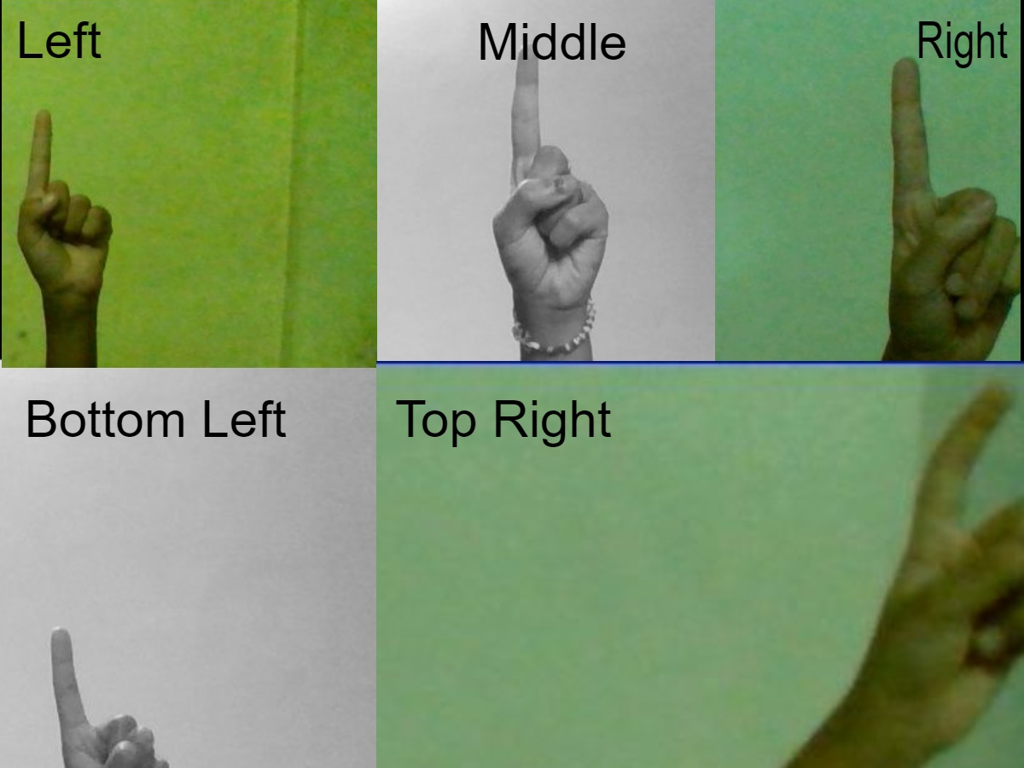
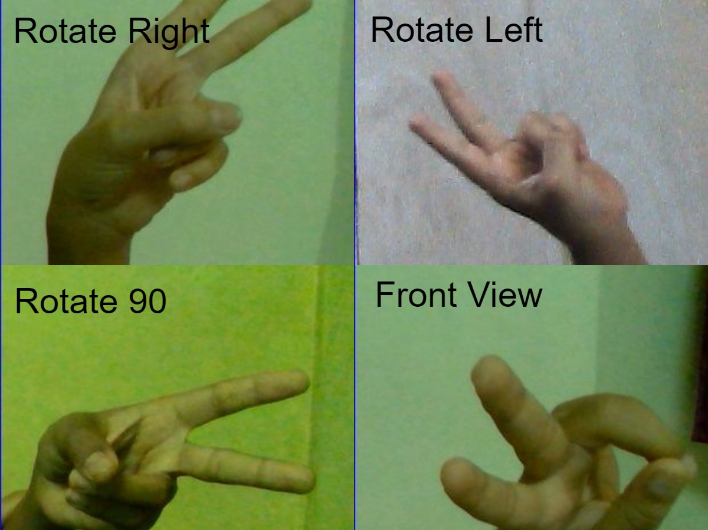
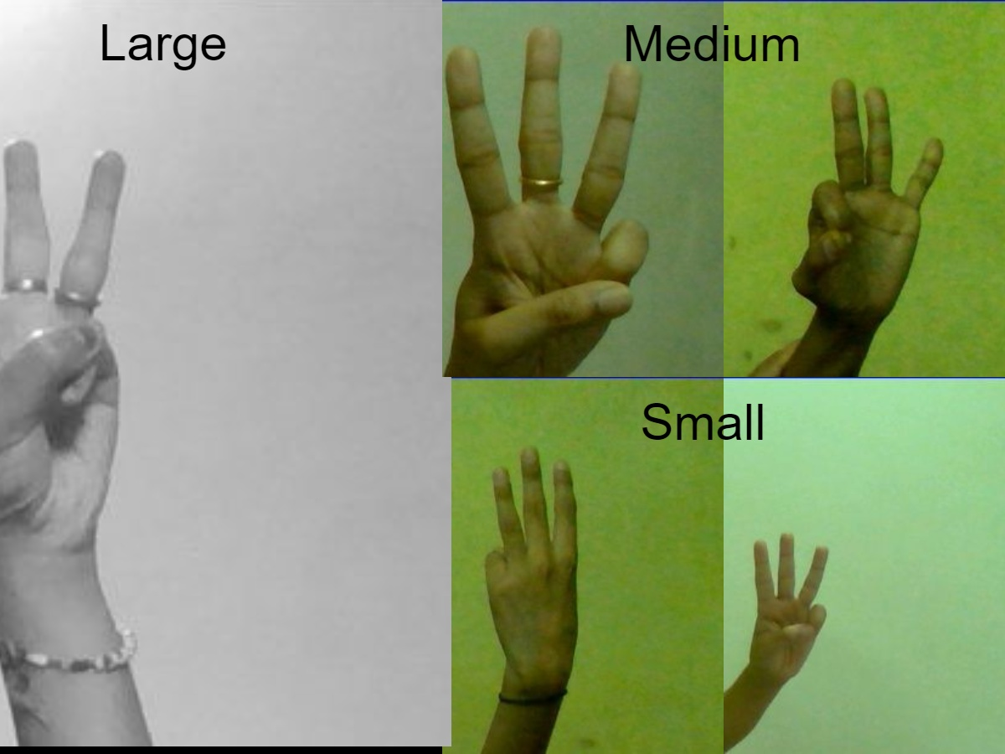
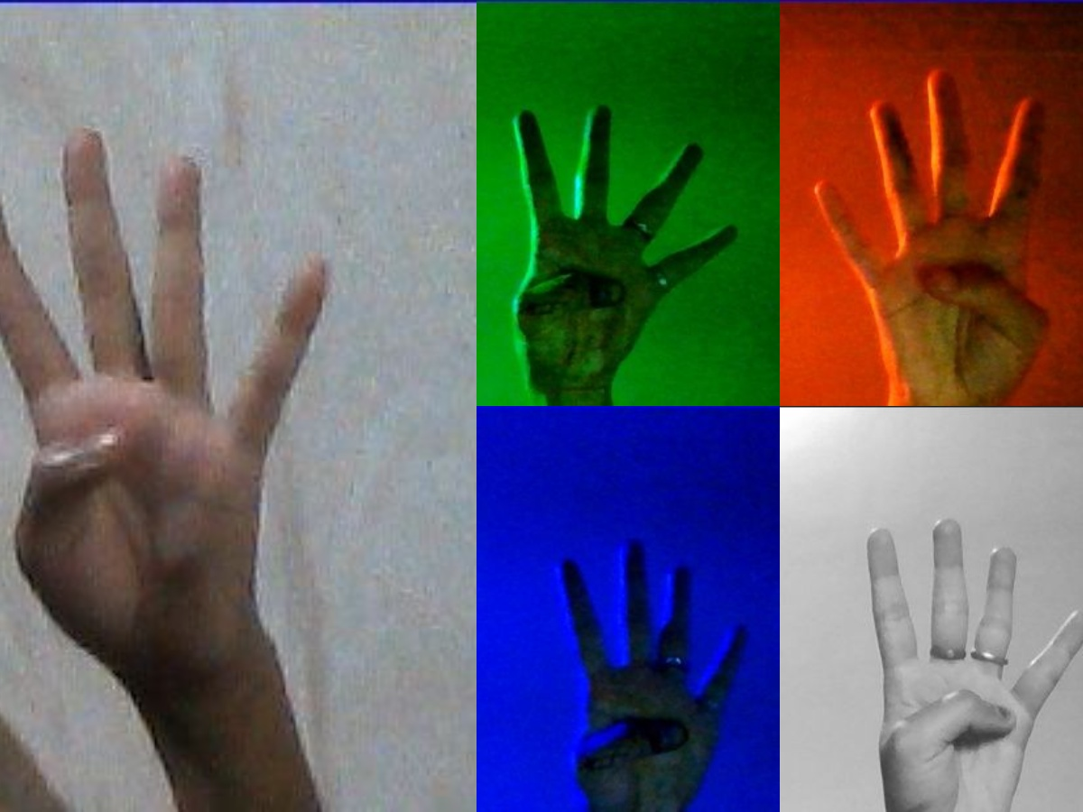
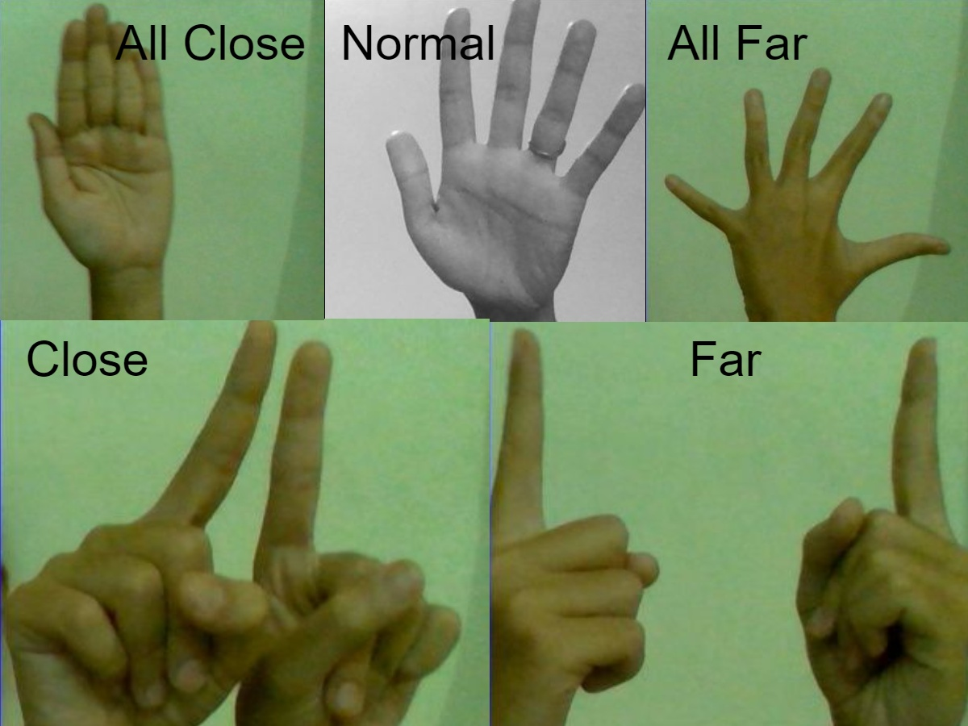
Dataset details
- Generating our own dataset with images of each sign (1 to 6).
Dataset contains images of hand gesture considering different Invariance .
Images are captured with the plain background.
Used Image resolution of (310*310) with Grayscale.
Positional Invariance Rotation Invariance Size Invariance Illumination Invariance
Different distance between fingers

Slide 7
Process flow (end-to-end)
Game will start.
Sign detection and machine will generate a number.
Ask user to Start
Based on rules decision is to be taken or scorecard will get updated
Start
Ask Chat Bot any query
Chat Bot
Output/ result is shown on the screen
Show appropriate respond to queries.

Slide 8
Image preprocessing
Manually deleting inappropriate images.
Resizing - Images are captured and resized using OpenCV library in (310,310) resolution
Color Channels - For the project we used grayscale images i.e. 1 channel per pixel.
As CNN accepts input of float data type, we changed the data type of our data into float.
Normalization of images : To ensure that each input parameter (pixels) has a similar data distribution.
Data Augmentation - We added more images to dataset via a number of random transformations, so that our model would never see twice the exact same picture.

Slide 9
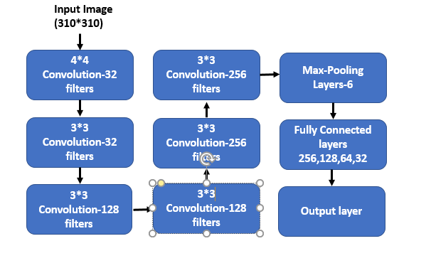
Model Building for hand sign detection
We have implemented Convolutional Neural Network (CNN) using tensorflow for hand sign detection.
Architecture of the model-

Slide 10
Chatbot
Steps to develop a chatbot-
Provide data to learn
Data with different intent, pattern and responses
Data pre-processing
Removing stop words, lower, stemming/ lemmatization
Take input from user and compare similarity with patterns in input data.
Do similar pre-processing and similarity check using cosine similarity to understand the intent.
Once intent of user is understood, return any random response from that intent.

Slide 11
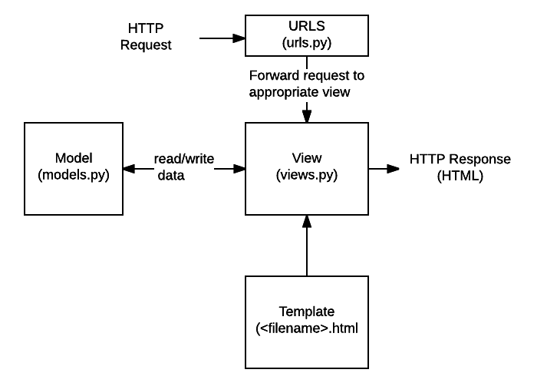
Web Integration using Django framework
Django is a high-level Python Web framework that encourages rapid development and clean, pragmatic design.
Help developers take applications from concept to completion as quickly as possible.
Helps developers avoid many common security mistakes.

Slide 12
Limitation-
Background should be clear/plain
Can only show palm in ROI
Only specific hand gestures allowed
Future Scope -
Game intelligence
Should work with any background
Adding voice module
Showing additional information on web page (Highest score etc.)

Slide 13
Demo

